Slide 1

Power BI Dashboard Summary Slides
Name: Kodumuri Venkat Rohith
Email: venkatrohith.kodumuri@gmail.com

Slide 2
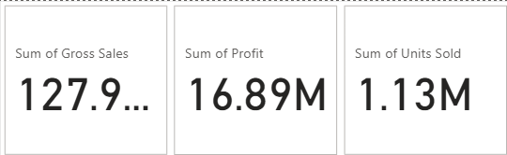
Financial Performance Summary
This slide presents high-level key performance indicators (KPIs) summarizing overall sales, profit, and units sold. These metrics provide a snapshot of the organization's financial health.

Slide 3
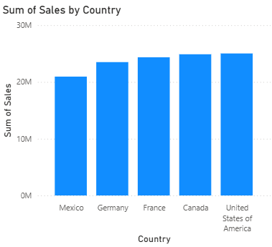
Total Sales by Country
Countries Covered: Mexico, Germany, France, Canada, United States
Insights:
The United States contributes the highest to total sales.
Mexico and Germany follow as the next significant markets.

Slide 4
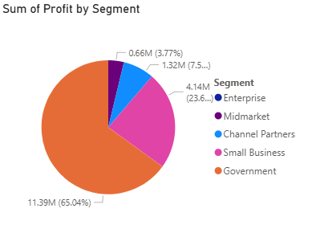
Segment-Wise Profit Distribution
Segments: Enterprise, Midmarket, Channel Partners, Small Business, Government
Insights:
The Enterprise segment dominates with over 65% of total profit.
Midmarket and Government segments have smaller contributions.

Slide 5
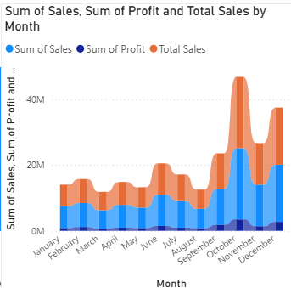
Comparative Analysis: Sales vs Profit by Country
Insights:
The U.S. shows a strong balance of high sales and profit.
Some countries have lower profit despite higher sales (e.g., Canada, France).

Slide 6
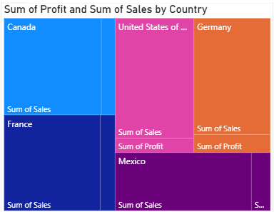
Monthly Sales and Profit Trends
Insights:
Sales and profit show periodic increases around mid-year.
Helps identify peak and low-performing months.

Slide 7
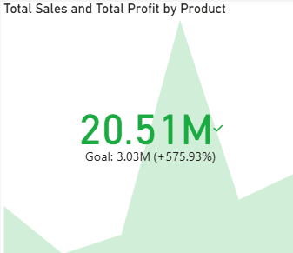
Total Sales and Profit by Product
Insights:
VTT, Velo, and Paseo appear as top-performing products.
Achieved significant sales increase over goal (+575%).

Slide 8
THANK YOU

